Slide 1



Introduction to
Data Structures and Algorithm
Martzel P. Baste

Slide 2

Intended Learning Outcomes
Understand the underlying concepts about data structures and algorithms
Identify different types of Data Structures and its characteristics
Discuss the need for choosing and selecting data structures
Determine the Data Structure Philosophy

Slide 3
What is Data Structure?
Name | Age | Price
Cortana | 7 | 7,500.00
Kodu | 3 | 10,000.00
Summer | 12 | 25,000.00
Satoshi | 10 | 12,000.00
Is a way to effectively perform operations of the data that has been collected and organized.
It is about rendering data elements in terms of some relationship, for better organization and storage.

Slide 4
Types of Data Structures
Data Structures
Primitive Data Structures
Integer
Float
Abstract Data Structure
Arrays
Character
Boolean
List
Files
Linear List
Non-Linear List
Stack
Queue
Trees
Graph

Slide 5
Classification of Data Structures (Characteristics)
Linear
Non-Linear
Homogeneous
Non-Homogeneous
Static
Dynamic
Array, Stack, Queue, LinkedList
Hierarchical (Tree, Graph, Trie, Heaps), Matrix
Array
Structure, Record, Classes, Union
Array
Pointers, LinkedList

Slide 6
Attributes of Data Structures
Name
Type
Size
Operations
Memory Address
Lifetime
Scope

Slide 7
Goals of Data Structures
Correctness
Efficiency

Slide 8

Features of Data Structure
Robustness
Adaptability
Reusability

Slide 9


Eﬃciency
A solution is said to be eﬃcient if it solves the problem within its resource constraints
Space
Time

Slide 10
The Need for Data Structures
Data structures organize data
more eﬃcient programs

Slide 11
The Need for Data Structures
Any organization for a collection of records can be searched, processed in any order, or modiﬁed.
Ex: Simple unordered array of records
Choosing data structure and algorithm can make the diﬀerence between a program running in a few seconds or many days.

Slide 12
Selecting a Data Structure
Analyze the problem
Quantify the resource constraints for each operation.
Select the data structure
Determine the basic operations that must be supported.

Slide 13
Selecting a Data Structure
Some questions we might ask often help to narrow the possibilities.
beginning, middle, or end
Can data be deleted?
Order or random

Slide 14
Data Structure Philosophy
has costs and beneﬁts.
doesn’t solve all problems

Slide 15
Data Structure Philosophy
time
space
programming eﬀort
A data structure requires:

Slide 16
Data Structure Philosophy
Each problem has constraints on available space and time.
Only after a careful analysis of problem characteristics can we know the best data structure for the task.

Slide 17
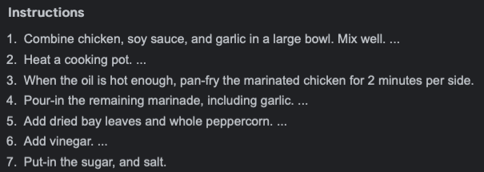
How About Algorithm?
*a method or a process followed to solve a problem

Slide 18

Properties of Algorithm
Input
Output
Definiteness
Finiteness
Correctness
Computer-implementable instructions

Slide 19
Examples of Algorithm?
Sorting
Merge Sort, Quick Sort, Tim Sort, etc.
Searching
Linear Search, Binary Search.
Shortest Path:
Dijkstra’s algorithm, Bellman-Ford algorithm

Slide 20
Note to every Programmer
There are costs and beneﬁts for every data structure.
Learn the commonly used data structures.
Measure the eﬀectiveness of a data structure or program.

Slide 21
Summary
Data Structure is about organizing and managing data
Algorithm is a step-by-step procedure to be followed to reach the desired output.
Understanding of memory allocation and space and time complexity to perform a specific operation on it.
Data Structures can use the same internal memory management and organization
Steps in an algorithm can use one or many data structure(s) to solve a problem.

Slide 22

Thank You
z

